Slide 1
Memory Allocation

Slide 2
First Fit
This method works as for any process P_{n}, the OS searches from starting block again and again and allocates a block to process P_{n} such that –
Block is available
Can fit the process

Slide 3
Example
Process
Block
Block No | Size
Block 1 | 20
Block 2 | 100
Block 3 | 40
Block 4 | 200
Blcok 5 | 10
Process No | Size
Process 1 | 90
Process 2 | 50
Process 3 | 30
Process 4 | 40

Slide 4
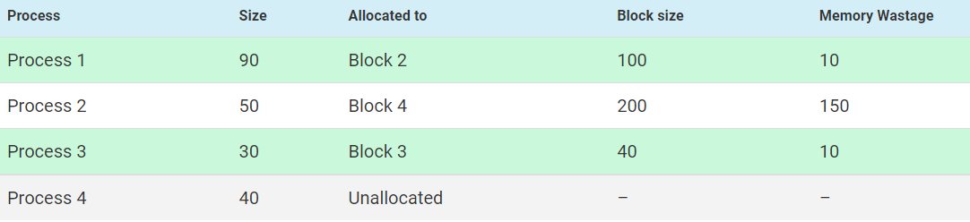
example

Slide 5
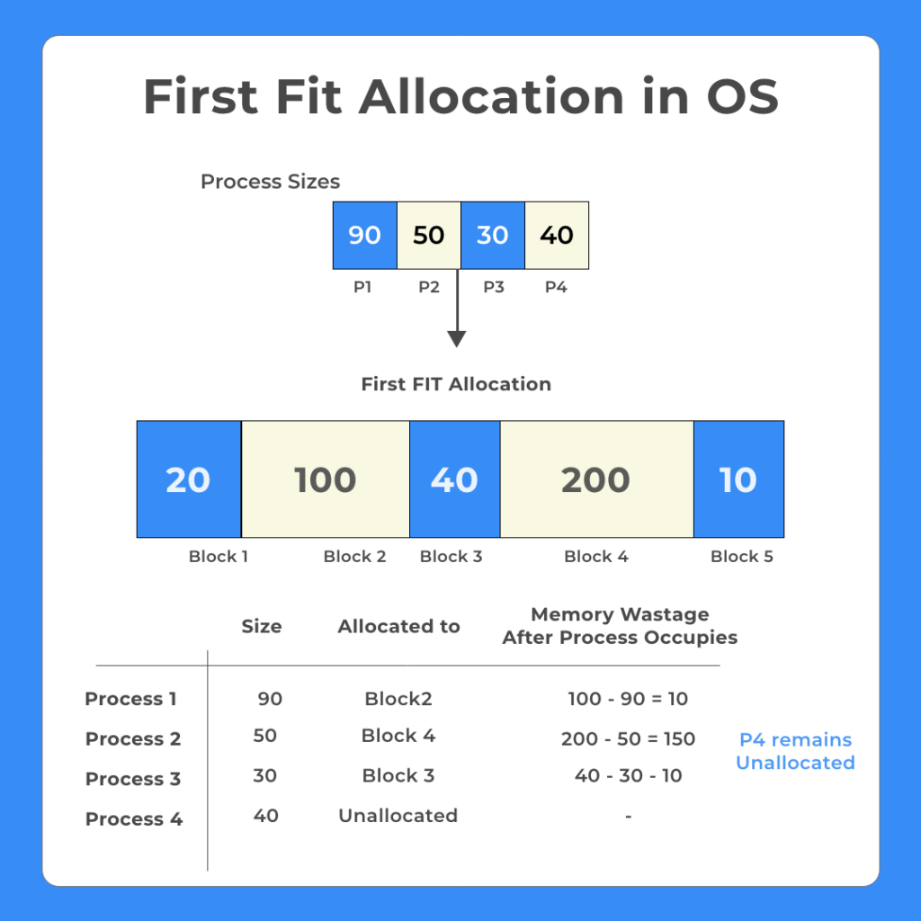
Notes:
This method works as for any process P_{n}, the OS searches from starting block again and again and allocates a block to process P_{n} such that –
Block is available
Can fit the process
https://prepinsta.com/operating-systems/first-fit-best-fit-worst-fit-in-os-example/

Slide 6
Next Fit
Next fit is a modified version of first fit. It begins as first fit to find a free partition. When called next time it starts searching from where it left off, not from the beginning.

Slide 7
Example
Process
Block
Block No | Size
Block 1 | 20
Block 2 | 100
Block 3 | 40
Block 4 | 200
Block 5 | 10
Process No | Size
Process 1 | 90
Process 2 | 50
Process 3 | 30
Process 4 | 40

Slide 8
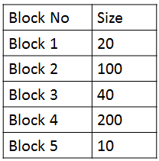
Example
Process No | Size | Allocated to | Block Size
Process 1 | 90 | Block 2 | 100
Process 2 | 50 | Block 4 | 200
Process 3 | 30 | Unallocated
Process 4 | 40 | unallocated

Slide 9
Best Fit
any process P_{n}, the OS searches from starting block again and again and allocates a block to process P_{n} such that –
Block can accommodate process
Memory wastage is minimum

Slide 10
Example
Process
Block
Block No | Size
Block 1 | 100
Block 2 | 50
Block 3 | 30
Block 4 | 120
Block 5 | 35
Process No | Size
Process 1 | 40
Process 2 | 10
Process 3 | 30
Process 4 | 60

Slide 11
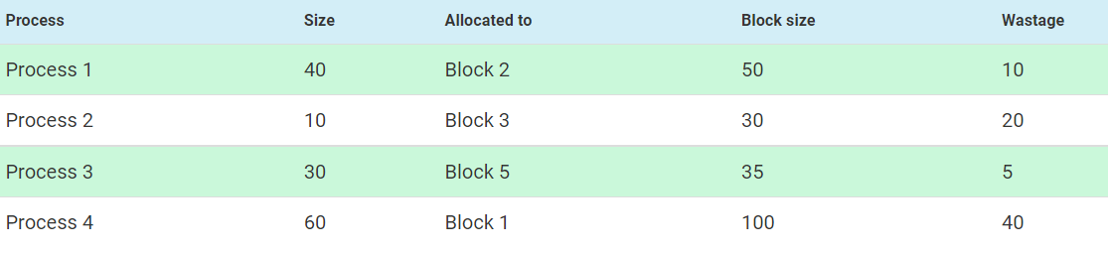
Example

Slide 12
Worst Fit
any process P_{n}, the OS searches from starting block again and again and allocates a block to process P_{n} such that –
Block can accommodate process
Memory wastage is maximum

Slide 13
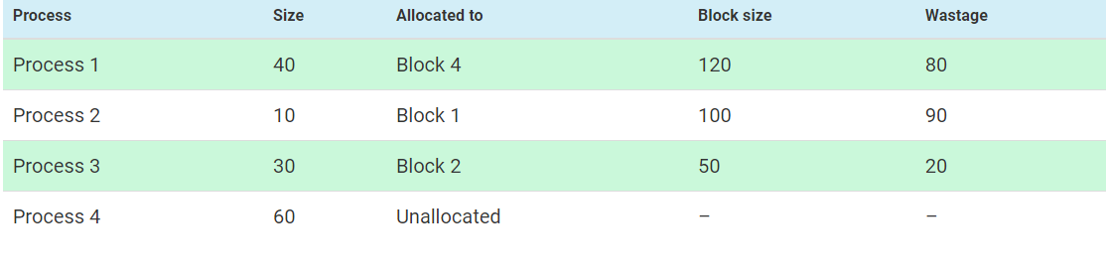
Example
Process
Block
Process No | Size
Process 1 | 40
Process 2 | 10
Process 3 | 30
Process 4 | 60
Block No | Size
Block 1 | 100
Block 2 | 50
Block 3 | 30
Block 4 | 120
Block 5 | 35
Notes:
Process 1 (size 40K)
Block 2 and 5 are smaller than P1 thus can not accommodate
Block1 memory wastage : 100 – 40 = 60
Block2 memory wastage: 50 – 40 = 10
Block4 memory wastage 120 – 40 = 80
Thus Block 4 is worst and P1 goes to block 4

